Slide 1

Vel Tech Rangarajan Dr. Sagunthala R&D Institute of Science and Technology
School of Computing
Department of Computer Science and Engineering
10211CS224 / FULL STACK APPLICATION DEVELOPMENT (JAVA)
PROJECT REVIEW : MILESTONE PROJECT – 1
Date: 26-03-2026
Full-Stack Skill Learning Academy Marketplace with Secure Authentication
SDG: SDG No – SDG 4- Quality Education
Presented By:
KAKARLA NITHISH KUMAR REDDY – VTU25914 – Reg.No:23UECS0751
Courses Handling Faculty:
Dr. Hafizur Rahman- B.E., M.Tech., Ph.D.

Slide 2
INTRODUCTION
This project is a web-based platform designed to provide online skill learning opportunities for users.
It allows users to register and login securely using authentication mechanisms like password hashing and session management.
The system supports different roles such as Student and Instructor with role-based access control.
Students can browse, search, and enroll in various courses available in the marketplace.
Instructors can create, update, and manage courses and track enrolled students.
The application is developed using HTML, CSS, JavaScript, PHP, and MySQL.
The main goal of this project is to provide an accessible, user-friendly, and secure online learning environment.
1
2
3
4
5
6
7
8
9

Slide 3
PROBLEM STATEMENT
In today’s digital era, many learners face difficulty in accessing a centralized platform that provides structured and affordable skill-based education.
Existing systems often lack proper organization of user roles, making it difficult to manage students, instructors, and administrators efficiently.
Many online platforms do not ensure secure authentication, leading to risks such as unauthorized access and data breaches.
There is a need for a system that allows instructors to easily create, manage, and update courses without technical complexity.
Traditional systems lack modular architecture, making maintenance, scalability, and feature enhancement difficult.
There is also a need for proper database management to store and retrieve user, course, and enrollment data efficiently.
Therefore, this project aims to develop a secure, modular, and role-based full-stack web application that addresses these challenges and provides an effective online learning marketplace.
1
2
3
4
5
6
7
8
9

Slide 4
OBJECTIVE(S)
To design a responsive and user-friendly interface
To ensure secure data storage using MySQL database
To prevent SQL injection using prepared statements
To build a modular and scalable system architect
To develop a full-stack web-based learning marketplace
To implement secure authentication using hashing and sessions
To provide role-based access for students and instructors
To enable course creation, management, and enrollment
To design a responsive and user-friendly interface
To ensure secure data storage using MySQL and prepared statements
1
2
3
4
5
6
7
8
9

Slide 5
PROPOSED SYSTEM
The system provides a centralized platform for online skill learning
It supports secure authentication using password hashing and sessions
Role-based access is implemented for students, instructors, and admin
Users can easily browse, search, and enroll in courses
Instructors can create, update, and manage course content
The system uses a modular architecture for better scalability and maintenance
Data is securely stored and managed using a MySQL database
1
2
3
4
5
6
7
8
9

Slide 6
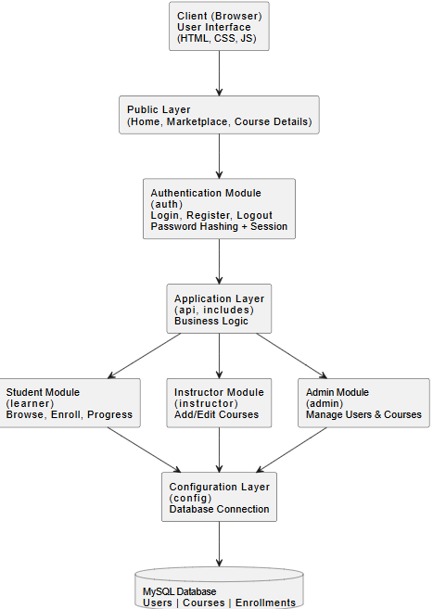
PROPOSED SYSTEM ARCHITECTURE
1
2
3
4
5
6
7
8
9

Slide 7
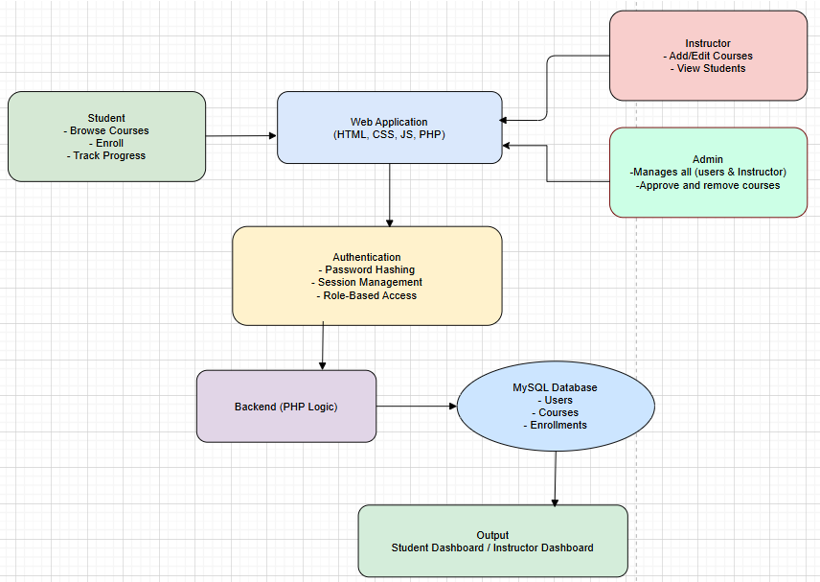
WORKFLOW
1
2
3
4
5
6
7
8
9

Slide 8
TECHNOLOGIES USED
Frontend:
HTML5
CSS3
Backend:
PHP (Core PHP)
Session Management
MySQL(Database Connectivity)
Database:
MySQL
phpMyAdmin
Tools:
XAMPP (Apache + MySQL Server)
Notepad
Web Browser (Chrome)
Hardware / Software Requirements:
System: Windows 10
RAM: Minimum 4GB
Software: XAMPP Server
1
2
3
4
5
6
7
8
9

Slide 9
MODULE DESCRIPTION
Module 1: User Authentication Module Handles user registration and login. Ensures secure access using password hashing and session management.
Module 2: Course Management Module Allows instructors to add, update, and delete courses. Displays available courses for students in the marketplace.
Module 3: Enrollment Module Enables students to enroll in courses. Manages enrollment records and course access.
Module 4: Learning & Progress Module Allows students to access enrolled courses. Tracks learning progress and completion status.
Module 5: Dashboard Module&Module Provides dashboards for students, instructors, and admin. Manages users, courses, and overall system activities.
1
2
3
4
5
6
7
8
9

Slide 10
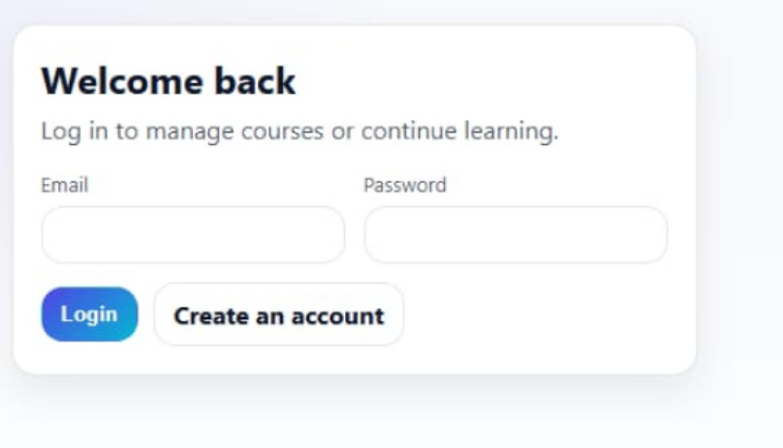
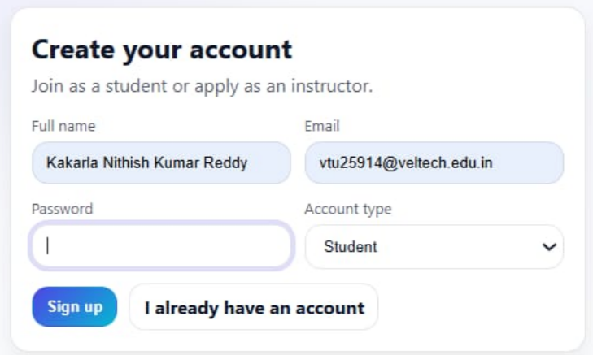
IMPLEMENTATION SCREENSHOTS
1
Login Page :
Allows registered users to enter email and password to access the system
Verifies credentials using secure authentication (password hashing & sessions)
Redirects users to respective dashboards based on their role (student/instructor/admin)
2
3
4
5
6
7
8
Register Page :
Enables new users to create an account by entering name, email, and password.
The system stores the user details securely in the database
After successful registration, the user can login and access the academy marketplace.
9

Slide 11
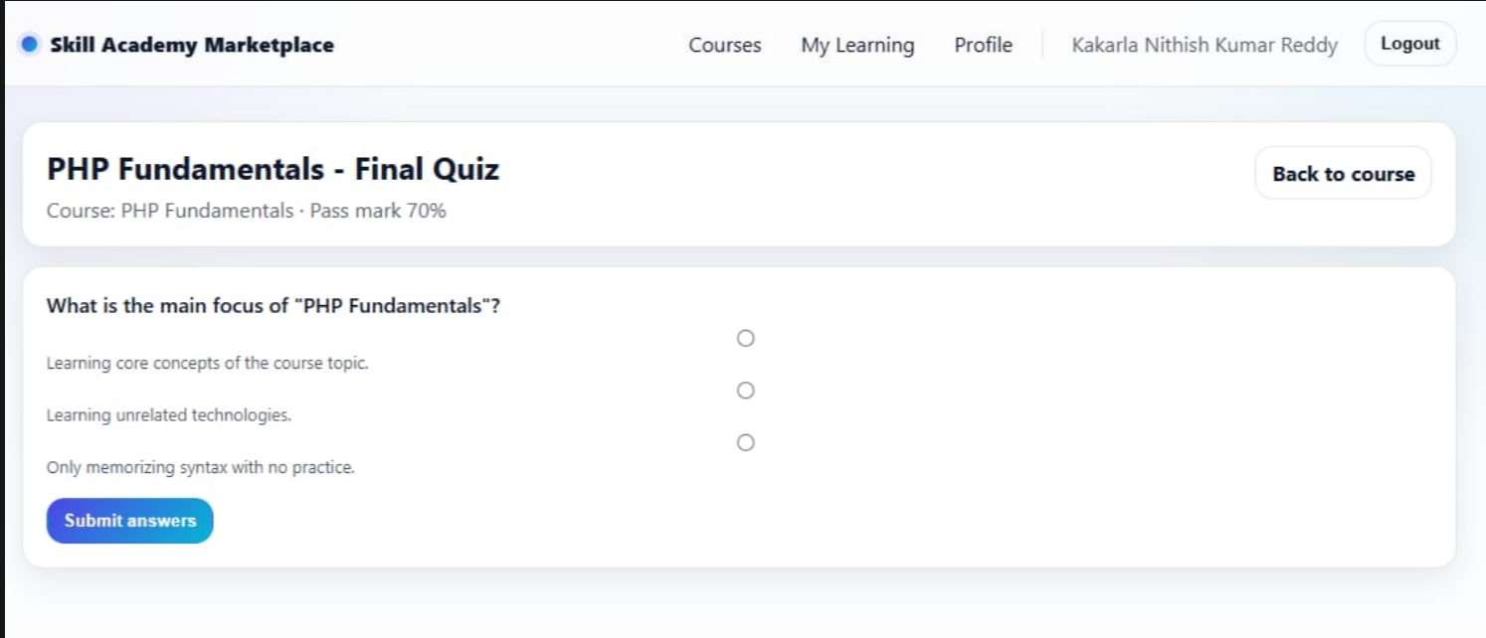
IMPLEMENTATION SCREENSHOTS
Quiz page:
Displays available courses and allows students to select and enroll
Provides course content and conducts assessments/exams for learning evaluation
Records student performance and updates progress based on results
1
2
3
4
5
6
7
8(A)
9

Slide 12
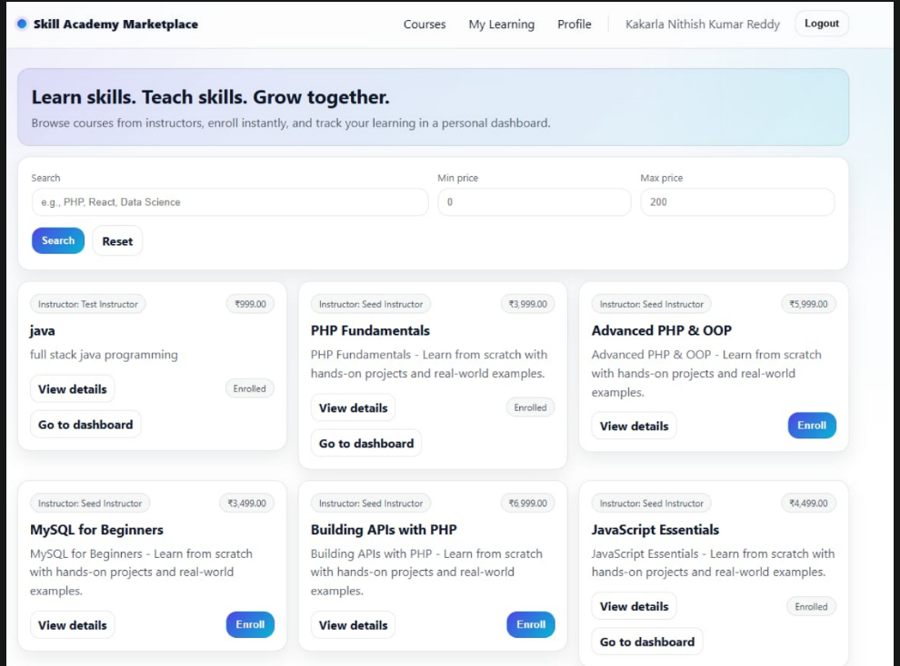
IMPLEMENTATION SCREENSHOTS
Course Marketplace
Displays available courses with details like title, description, and price
Allows users to search, filter, and select courses for enrollment
1
2
Displays all courses enrolled by the student in one place
Allows users to access course content and track their learning progress
3
4
5
6
7
8(B)
9

Slide 13
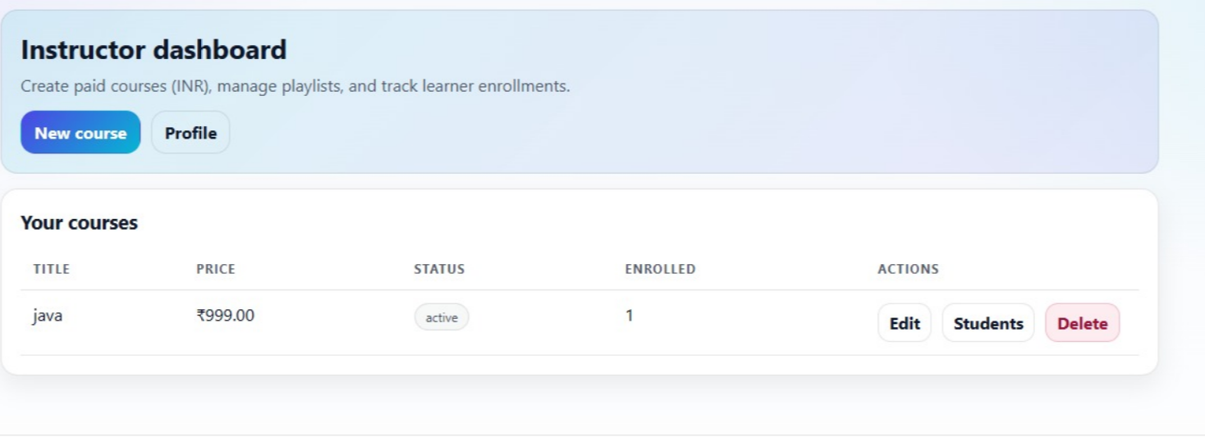
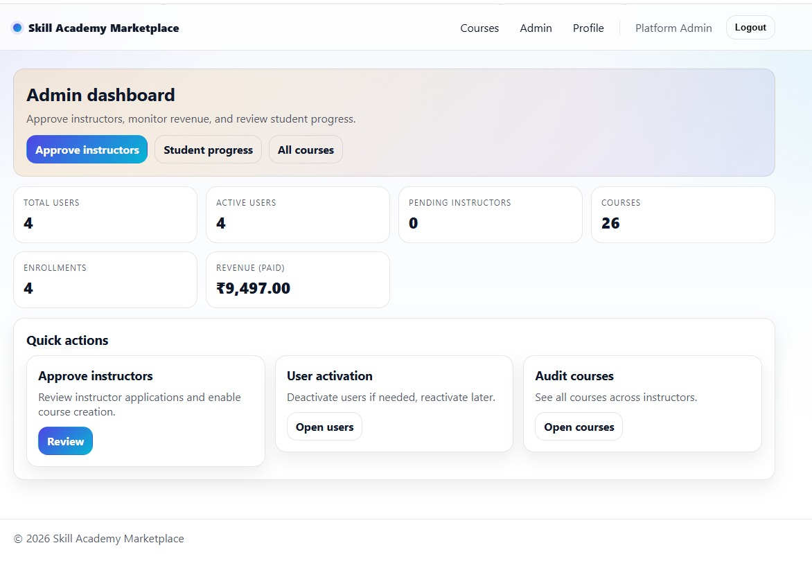
IMPLEMENTATION SCREENSHOTS
1
Instructor Dashboard:
Displays all courses created by the instructor
Allows instructors to edit, update, or delete their courses
2
3
4
5
6
7
Admin Dashboard
Provides overview of users, courses, and system activities
Allows admin to manage users, courses, and platform operations
8(C)
9

Slide 14
ADVANTAGES & LIMITATIONS
Advantages
Provides a centralized online learning platform
Secure authentication ensures data safety
Role-based access improves system control
Easy course management for instructors
User-friendly and responsive interface
Scalable and modular architecture
Disadvantages
Requires internet connection to access
Basic security (not fully industry-level)
Depends on server performance (XAMPP/local)
Limited features compared to large platforms
Maintenance required for updates
1
2
3
4
5
6
7
8
9

Slide 15
Thank you

